Slide 1
Chapter 4
The Processor
Notes:
Morgan Kaufmann Publishers
Chapter 4 — The Processor

Slide 2
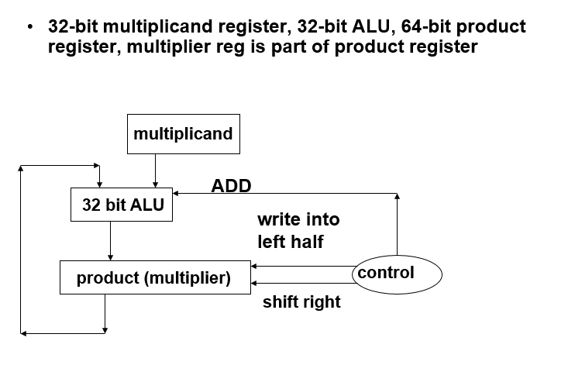
Review Multiplier/Divider
Chapter 4 — The Processor — <number>

Slide 3
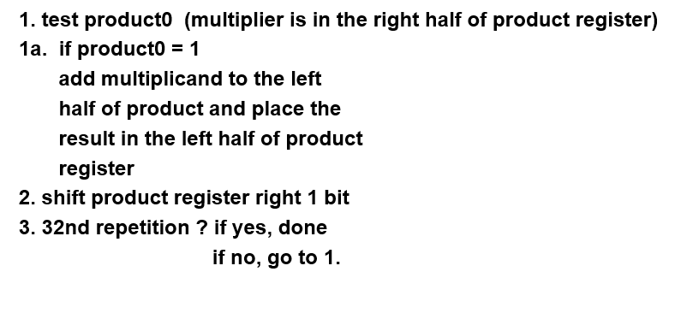
Multiplier Algorithm
Chapter 4 — The Processor — <number>

Slide 4
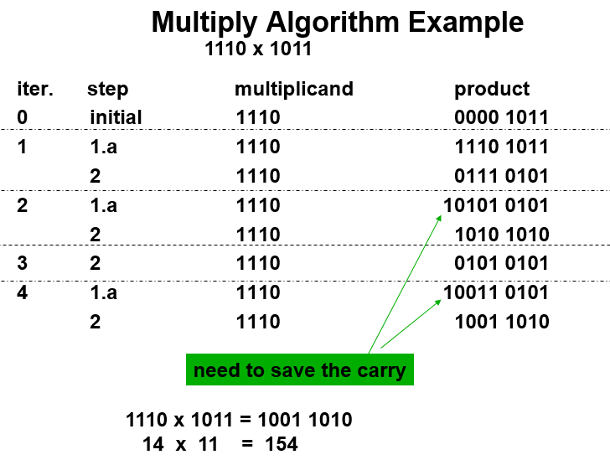
Chapter 4 — The Processor — <number>

Slide 5
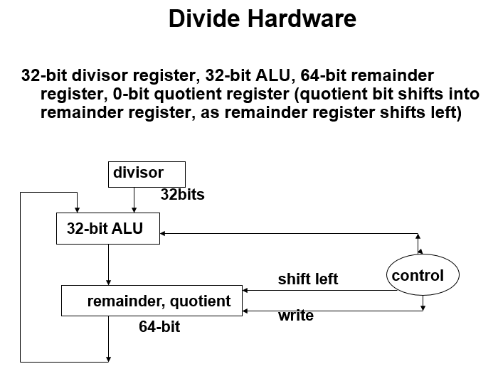
Chapter 4 — The Processor — <number>

Slide 6
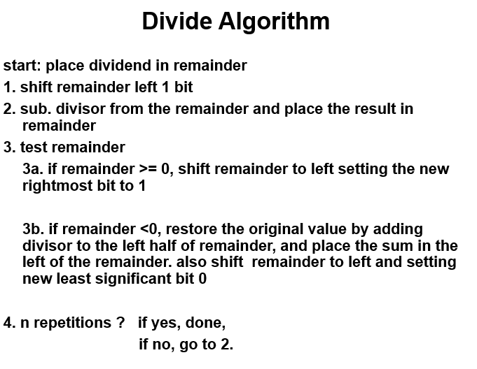
Chapter 4 — The Processor — <number>

Slide 7
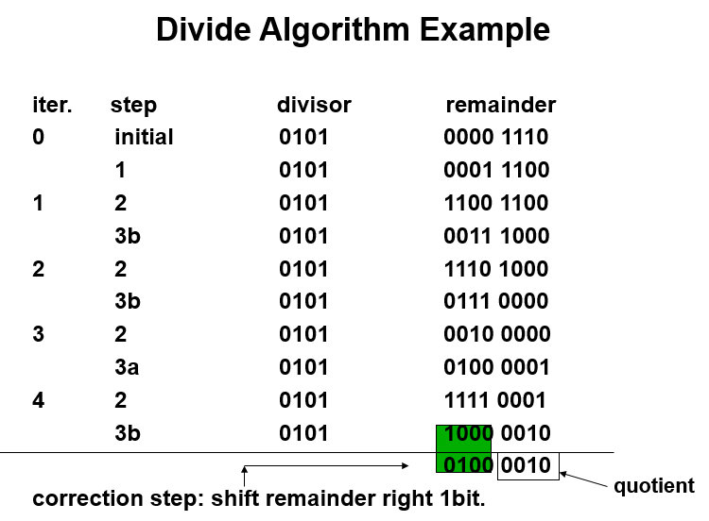
Chapter 4 — The Processor — <number>

Slide 8
Introduction
CPU performance factors
  Instruction count
    Determined by ISA and compiler
  CPI and Cycle time
    Determined by CPU hardware
We will examine two MIPS implementations
  A simplified version
  A more realistic pipelined version
Simple subset, shows most aspects
  Memory reference: lw, sw
  Arithmetic/logical: add, sub, and, or, slt
  Control transfer: beq, j
Chapter 4 — The Processor — <number>
Notes:
Morgan Kaufmann Publishers
Chapter 4 — The Processor

Slide 9
Instruction Execution
PC → instruction memory, fetch instruction
Register numbers → register file, read registers
Depending on instruction class
  Use ALU to calculate
    Arithmetic result
    Memory address for load/store
    Branch target address
  Access data memory for load/store
  PC ← target address or PC + 4
Chapter 4 — The Processor — <number>
Notes:
Morgan Kaufmann Publishers
Chapter 4 — The Processor

Slide 10
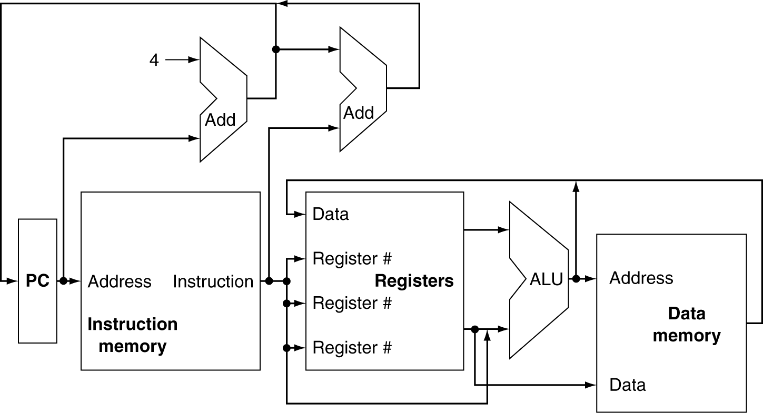
CPU Overview
Chapter 4 — The Processor — <number>
Notes:
Morgan Kaufmann Publishers
Chapter 4 — The Processor

Slide 11
Multiplexers
Can’t just join wires together
  Use multiplexers
Chapter 4 — The Processor — <number>
Notes:
Morgan Kaufmann Publishers
Chapter 4 — The Processor

Slide 12
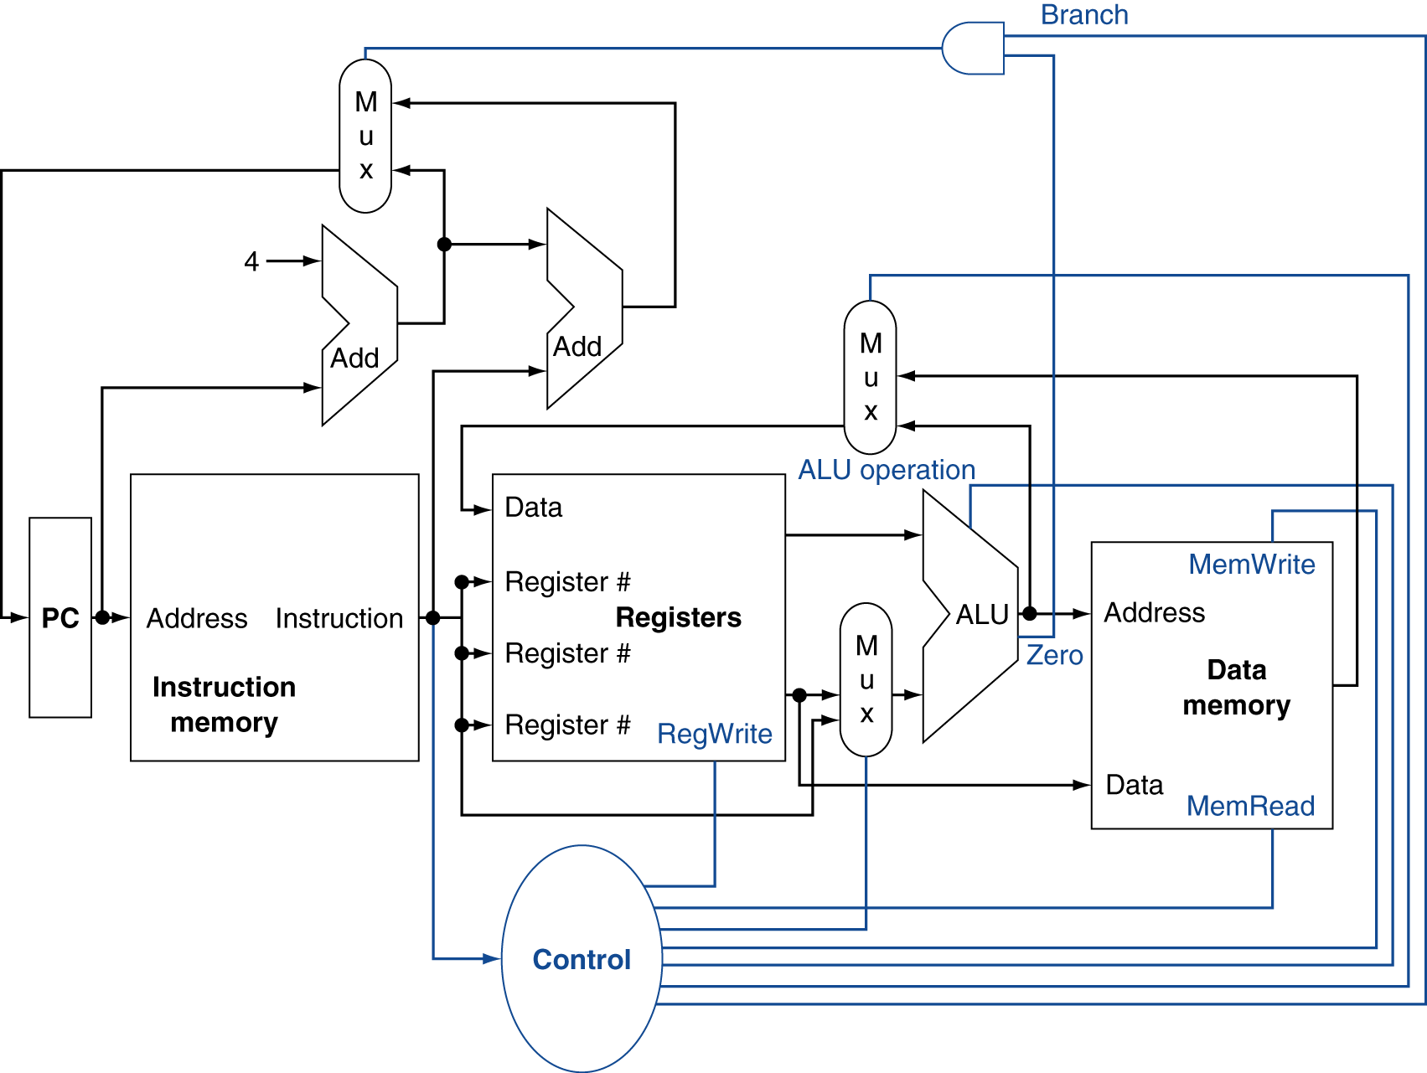
Control
Chapter 4 — The Processor — <number>
Notes:
Morgan Kaufmann Publishers
Chapter 4 — The Processor

Slide 13
Logic Design Basics
Information encoded in binary
  Low voltage = 0, High voltage = 1
  One wire per bit
  Multi-bit data encoded on multi-wire buses
Combinational element
  Operate on data
  Output is a function of input
State (sequential) elements
  Store information
Chapter 4 — The Processor — <number>
Notes:
Morgan Kaufmann Publishers
Chapter 4 — The Processor

Slide 14
Combinational Elements
AND-gate
  Y = A & B
Adder
  Y = A + B
A
+
Y
B
A
Y
B
Arithmetic/Logic Unit
  Y = F(A, B)
Multiplexer
  Y = S ? I1 : I0
A
I0
M
u
x
Y
Y
ALU
I1
B
S
F
Chapter 4 — The Processor — <number>
Notes:
Morgan Kaufmann Publishers
Chapter 4 — The Processor

Slide 15
Sequential Elements
Register: stores data in a circuit
  Uses a clock signal to determine when to update the stored value
  Edge-triggered: update when Clk changes from 0 to 1
Clk
D
Q
D
Clk
Q
Chapter 4 — The Processor — <number>
Notes:
Morgan Kaufmann Publishers
Chapter 4 — The Processor

Slide 16
Sequential Elements
Register with write control
  Only updates on clock edge when write control input is 1
  Used when stored value is required later
Clk
D
Q
Write
Write
D
Clk
Q
Chapter 4 — The Processor — <number>
Notes:
Morgan Kaufmann Publishers
Chapter 4 — The Processor

Slide 17
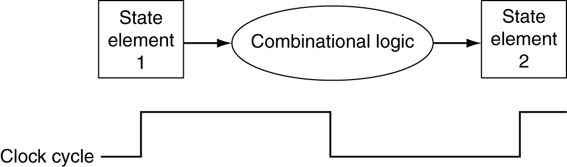
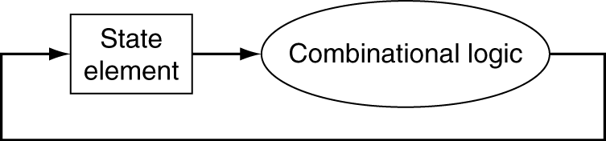
Clocking Methodology
Combinational logic transforms data during clock cycles
  Between clock edges
  Input from state elements, output to state element
  Longest delay determines clock period
Chapter 4 — The Processor — <number>
Notes:
Morgan Kaufmann Publishers
Chapter 4 — The Processor

